Slide 1
A Fiaz Ahamed
Object detection using CNN for Autonoumous Vehicles
3/21/2024 Annual Review

Slide 2
OBJECT DETECTION USING CNN FOR AUTONOMOUS VEHICLES
3/21/2024 Annual Review

Slide 3


AGENDA
Introduction to Autonomous Vehicles
Understanding Object Detection
Convolutional Neural Networks (CNNs)
CNN-Based Object Detection Techniques
CNNs in Autonomous Vehicles
3/21/2024 Annual Review

Slide 4

PROBLEM STATEMENT
Challenges:
Complex Environment Interpretation: Autonomous vehicles require precise and real-time identification of multiple objects (vehicles, pedestrians, road signs) in diverse and changing conditions.
Balancing Speed and Accuracy: Achieving high accuracy in object detection without compromising processing speed remains a significant technical challenge, crucial for the safety and efficiency of autonomous navigation.
Continuous Adaptation: The system must continually evolve and adapt to new objects and scenarios due to the dynamic nature of driving environments.
3/21/2024 Annual Review

Slide 5

PROJECT OVERVIEW
Objective: Implement YOLO (You Only Look Once) to improve real-time object detection in autonomous vehicles, enhancing safety and navigation.
Why YOLO?
Speed: Real-time processing for immediate environmental interpretation.
Accuracy: High precision in object detection, crucial for autonomous decision-making.
Efficiency: Single-step detection significantly reduces computational load.
Implementation:
Optimized YOLO model trained on diverse datasets for robust detection across conditions.
Achievements:
Achieved real-time, accurate object detection under various conditions.
Enhanced vehicle safety and operational efficiency.
3/21/2024 Annual Review

Slide 6

WHO ARE THE END USERS?
Automotive Manufacturers
Tech Companies
Regulatory Bodies and Safety Organizations
Consumers
3/21/2024 Annual Review

Slide 7

YOUR SOLUTION AND ITS VALUE PROPOSITION
Interpretation:
Multi-Class Detection: Identifies vehicles, pedestrians, and road signs simultaneously.
Robust Training: Diverse datasets ensure adaptability.
Speed and Accuracy:
Optimized Architecture: Balances real-time detection with accuracy.
Hardware Acceleration: Enhances processing speed without loss of precision.
Continuous Adaptation:
Incremental Learning: Adapts to new objects and scenarios.
Dynamic Updates: Ensures ongoing adaptation to changing environments.
3/21/2024 Annual Review

Slide 8

THE WOW IN YOUR SOLUTION
Integration of Semantic Segmentation with YOLO
In addition to traditional object detection, semantic segmentationhas been incorporated alongside YOLO for more precise understanding of the vehicle's surroundings.
3/21/2024 Annual Review

Slide 9
MODELLING
YOLO Architecture Overview:
Real-time object detection through a single neural network pass.
Backbone Network:
Feature extraction using Darknet or YOLOv3.
Detection Head:
Multi-class detection and bounding box regression.
Training Process:
Data preprocessing, loss functions, optimization.
Performance Metrics:
mAP, precision, recall for safety and efficiency.
Customizations:
Tailored modifications for autonomous vehicle scenarios.
Validation and Testing:
Results demonstrate accuracy and robustness.
3/21/2024 Annual Review

Slide 10
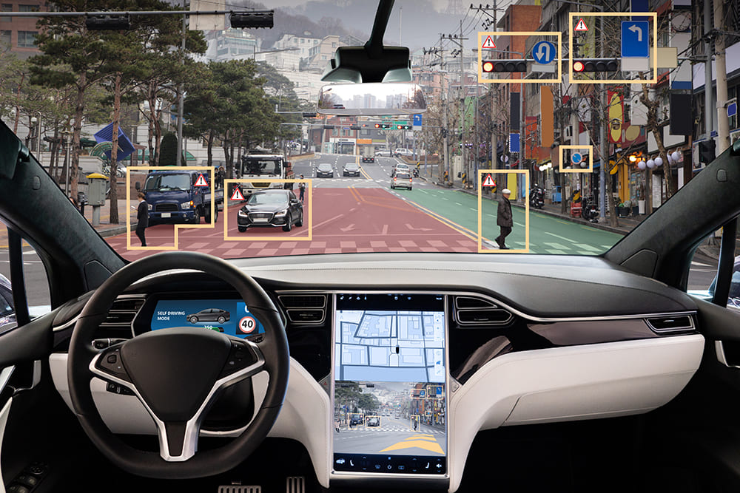
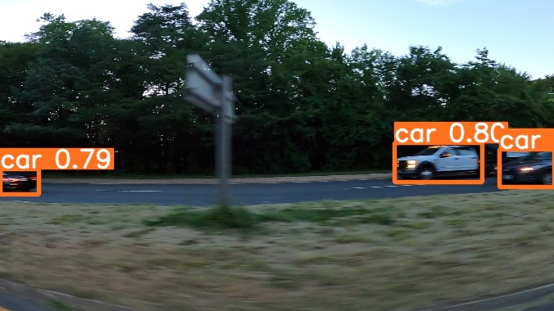
RESULTS
Demo Link
3/21/2024 Annual Review

